Slide 1



DATA SCIENCE PRODEGREE PROJECT
WIN Prediction Analytics
DSP 05 – Group 3
31 July 2021
Analysts: Group 3 (A-Z)
Mahesh MS
Neha Bedi
Nitish Rai
Praveen Kumar
Priyadarshini Rai

Slide 2
Roadmap to achieving the objective Predictive Analytics Prescriptive Analytics
1
Prescriptive Analytics: Structuring data and Feature engineering
Missing value imputation
Removing Duplicate values
Feature selection
2
Predictive Analytics: Identifying and Building the model on Python
Python as a statistical software
Logistic Regression model
KNN , Decision tree and random forest
3
To make sure we achieve both objectives in predictive and prescriptive analytics with proved results

Slide 3

Prescriptive Analytics
Objective is to identify variable/s that are most likely to help in converting an opportunity into a win.

Slide 4
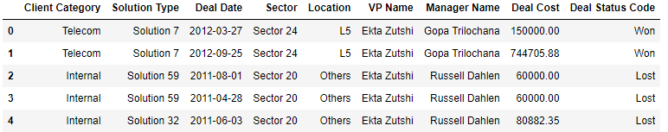
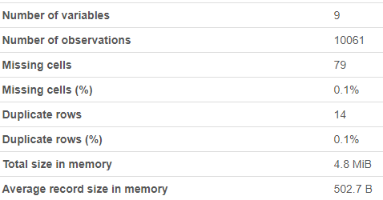
Sample Dataset
High level Dataset Statistics

Slide 5
Dependent and independent of the data
Client Category*
Location*
01
02
Deal Status**
End Game
Win / Loss
Solution Type*
06
03
VP -Bid Manager Combination*
05
04
Sector*
Deal Cost*
** Dependent variable
* independent variable

Slide 6
Data Preparation (Data errors, correction and manipulation)
Missing Value Imputation
Client Category: 79 missing values found, and imputed using mode
Deal Cost: Removed all records with Zero value
Zero Values
Redundant Variables
14 duplicate rows were found and removed from the dataset
There is no start and end date and we decided to drop the variable as this will
not bring any valuable insights to the model
Removed deal date

Slide 7

Feature Engineering

Slide 8
Ratio of Test to Train Data Split
Data Set
100%
Training Data
70%
Testing Data
30%

Slide 9
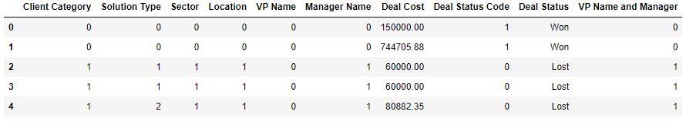
Converting Categorical Variables into Continuous with Label Encoding
Why Label encoding is an essential step for us?
We are dealing with categorical variables in this problem, Label Encoding is a popular encoding technique for handling categorical variables. In this technique, each label is assigned a unique integer based on alphabetical ordering as represented in the below table.

Slide 10
Feature Selection using Chi-Square test
Variables | P values
Solution Type | 8.84E-272
Client Category | 1.86E-65
VP Name | 5.42E-21
Location | 4.73E-12
Sector | 4.28E-10
VP Name and Manager | 7.81E-02
Manager Name | 1.67E-01
Inference:
The adjacent table shows the impact of each variable on the deal status. smaller the p-value, the stronger the variable.

Slide 11

Predictive Analytics
Objective is to Build a ML model to predict the probability of win/loss for bidding activities for a potential client.

Slide 12
Machine Learning algorithms used
We are using the below models as we are dealing with factor data and we recognize the below models can predict the deal status with proven result.
01
03
Logistic Regression
Decision tree
02
04
K nearest neighbor
Random forest

Slide 13
Accuracy achieved for each model
Logistic regression
K Nearest Neighbor
Logistic regression
KNN
73.15%
62.70%
Random Forest
Decision tree
Random Forest
Decision Tree
78.58%
80.04%

Slide 14
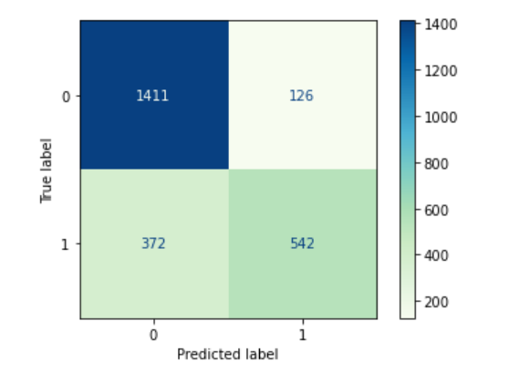
Evaluation and Confusion Matrix for Random Forest
From the confusion matrix we got 496 false predictions.
TN = 1411
TP = 542
FN = 372
FP = 126

Slide 15
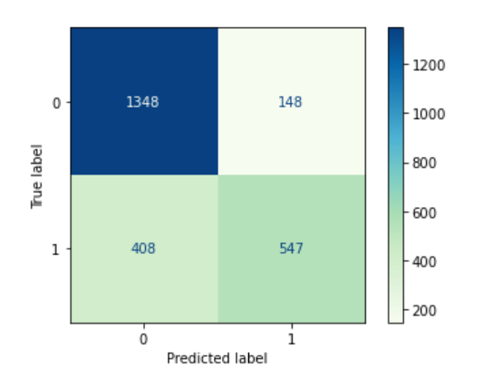
Evaluation and Confusion Matrix for Decision Tree
From the confusion matrix we got 556 false predictions.
TN = 1348
TP = 547
FN = 408
FP = 148

Slide 16
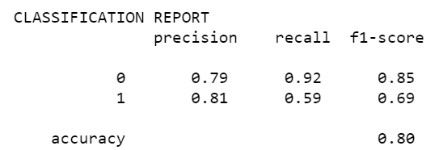
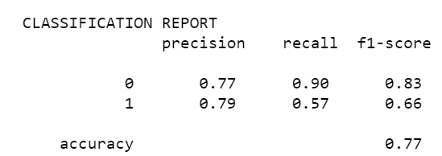
Random Forest
Model Performance Evaluation
Decision Tree

Slide 17
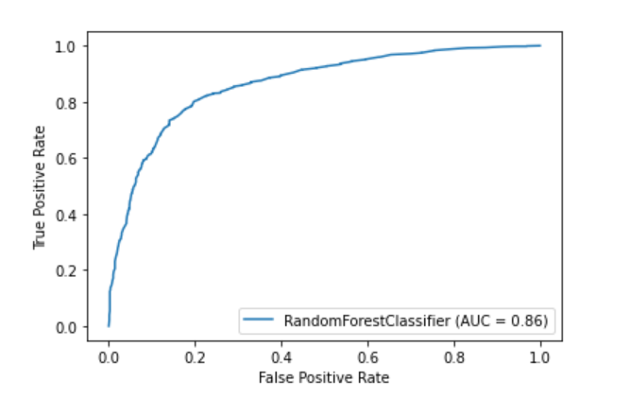
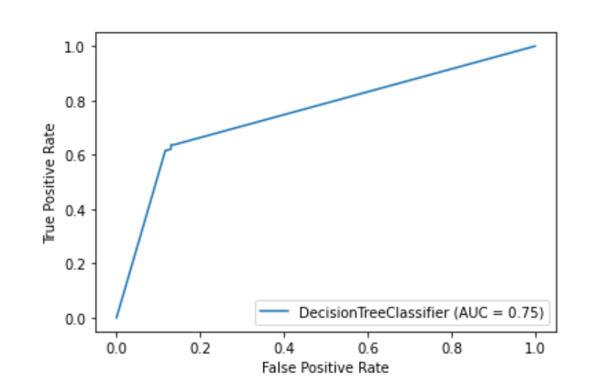
AUC (Area Under the Curve)
Random Forest
Decision Tree

Slide 18
Best Bid Manager and VP combination (Based on Maximum number of deals won)
VP Name | Manager Name | Avg of Deal Cost (mns) | Won deals (%) | Won deals (no)
Long Bergstrom | Russell Dahlen | 0.84 | 71.43 | 75
Rahul Bajpai | Rudraksh Sharma | 0.47 | 36.36 | 72
Neeraj kumar | Molly Eakes | 0.79 | 43.06 | 62
Ankita Aggarwal | Desmond Krout | 0.25 | 24.88 | 53
Neeraj kumar | Vinay Kumar | 0.74 | 68.00 | 51

Slide 19
Best Bid Manager and VP combination (Based on Average Deal Cost)
VP Name | Manager Name | Avg of Deal Cost (mns) | Won deals (%) | Won deals (no)
Ekta Zutshi | Jitendra Choudhary | 6.34 | 64.71 | 11
Brendon Wycoff | Vansu dev | 3.54 | 33.33 | 10
Mangesh K. Singh | Shobhit Gupta | 2.32 | 37.50 | 12
Brendon Wycoff | Virak Kandpal | 2.12 | 41.67 | 10
Ekta Zutshi | Rahul Bajpai | 2.09 | 64.71 | 11

Slide 20
False predictions by Random Forrest
Random Forrest
False Positives
The model predicted 126 losses as wins and 372 wins as losses
Value of False Positives
The total deal cost for false wins is 106.18 million
Decision Tree
False Positives
The model predicted 148 losses as wins and 408 wins as losses
.
Value of False Positives
The total deal cost for false wins is 125.44 million

Slide 21
Questions ?

Slide 22
Thank you

